Slide 1
Data Visualization And Analytics Lab Social Media Analysis
By
Sagarika Jaywant – B62
Shreya Rai – B63

Slide 2
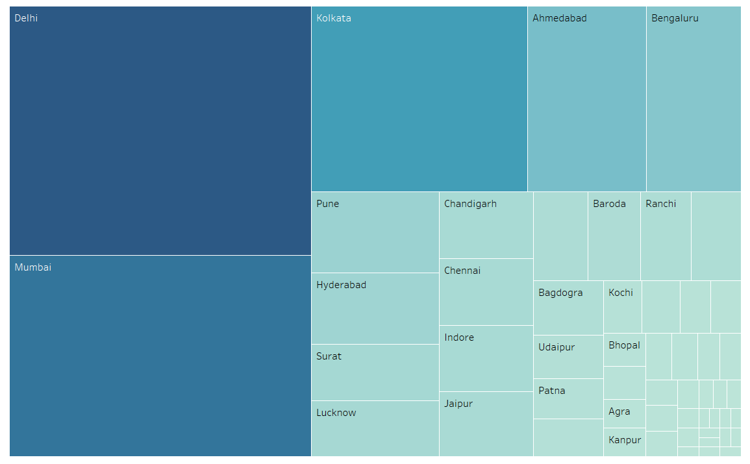
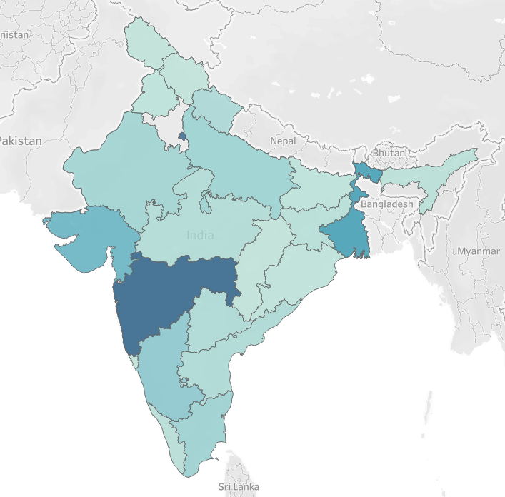
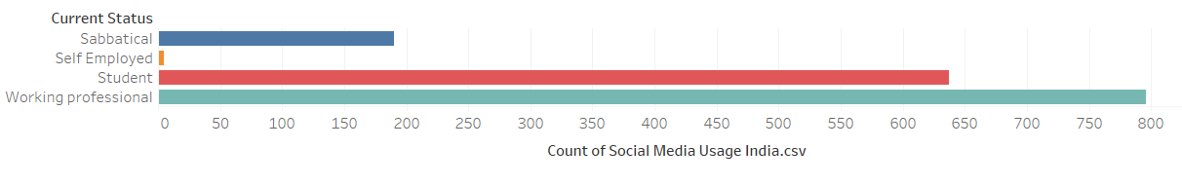
Total social media usage across cities in India
Total social media usage across states in India
Total social media usage with current status of individual

Slide 3
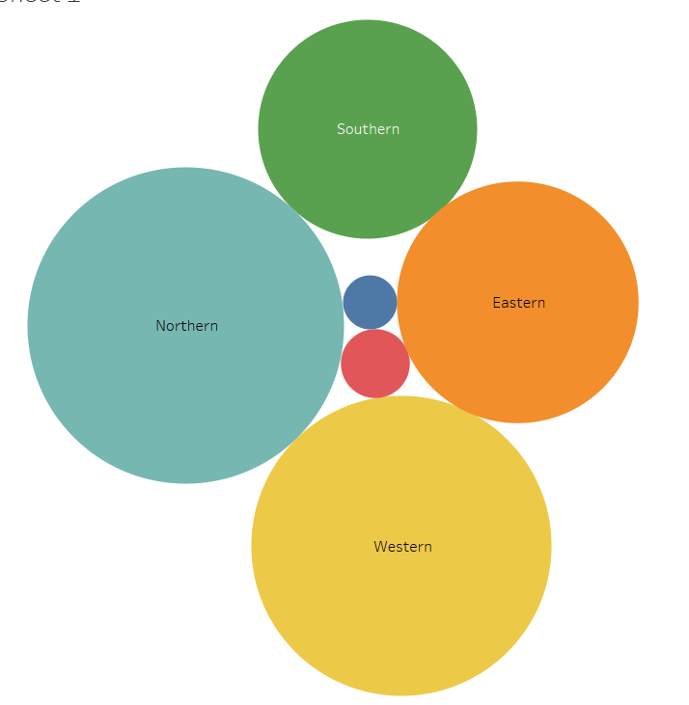
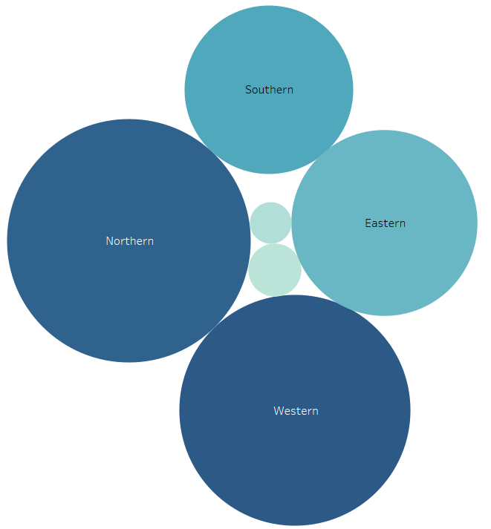
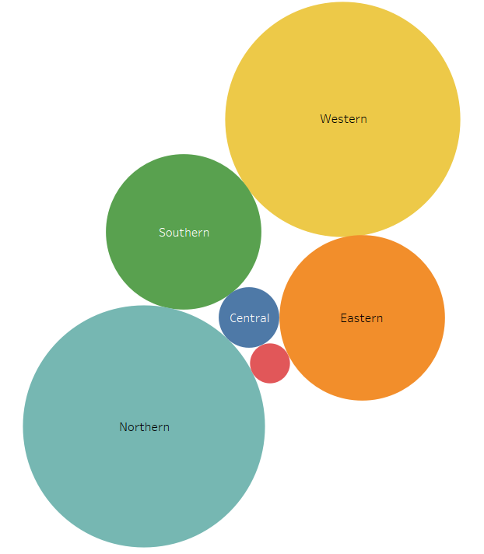
Social media usage across various zones in India
Facebook
Instagram
Whatsapp

Slide 4
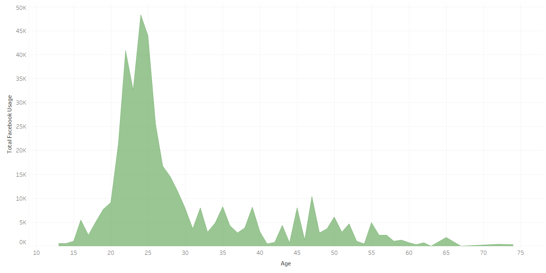
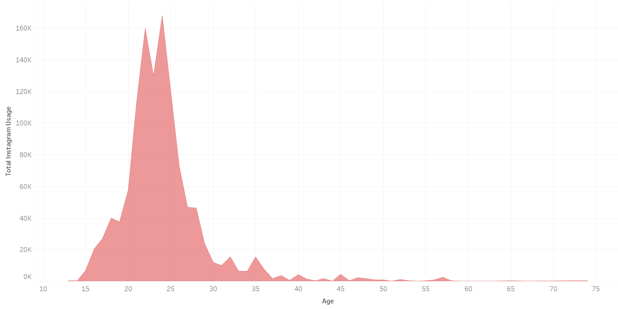
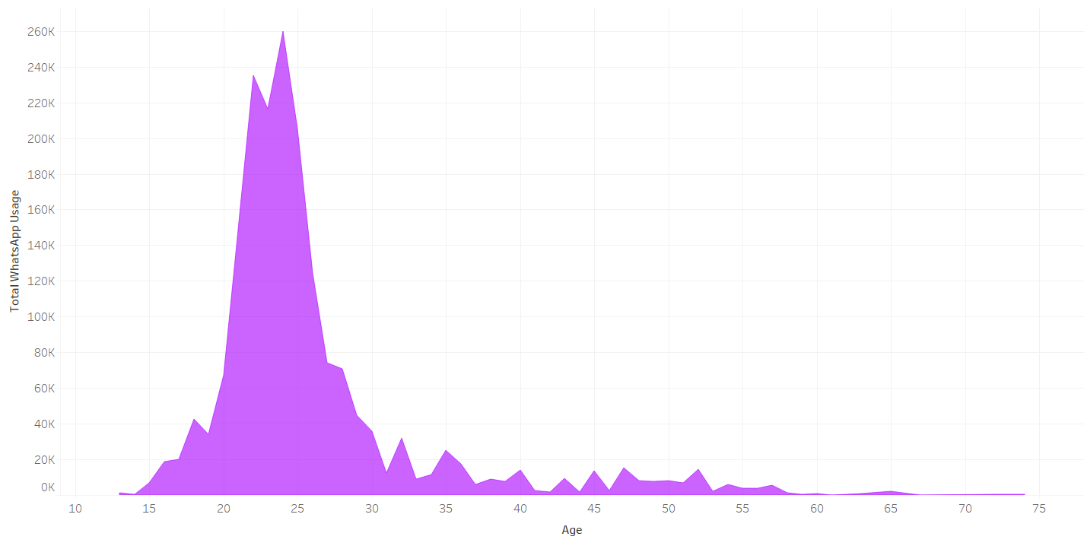
Social media usage spread across various age groups
Facebook
Instagram
Whatsapp

Slide 5
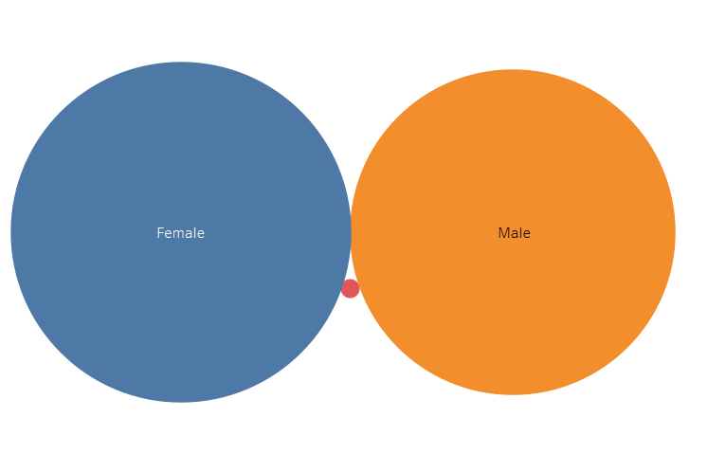
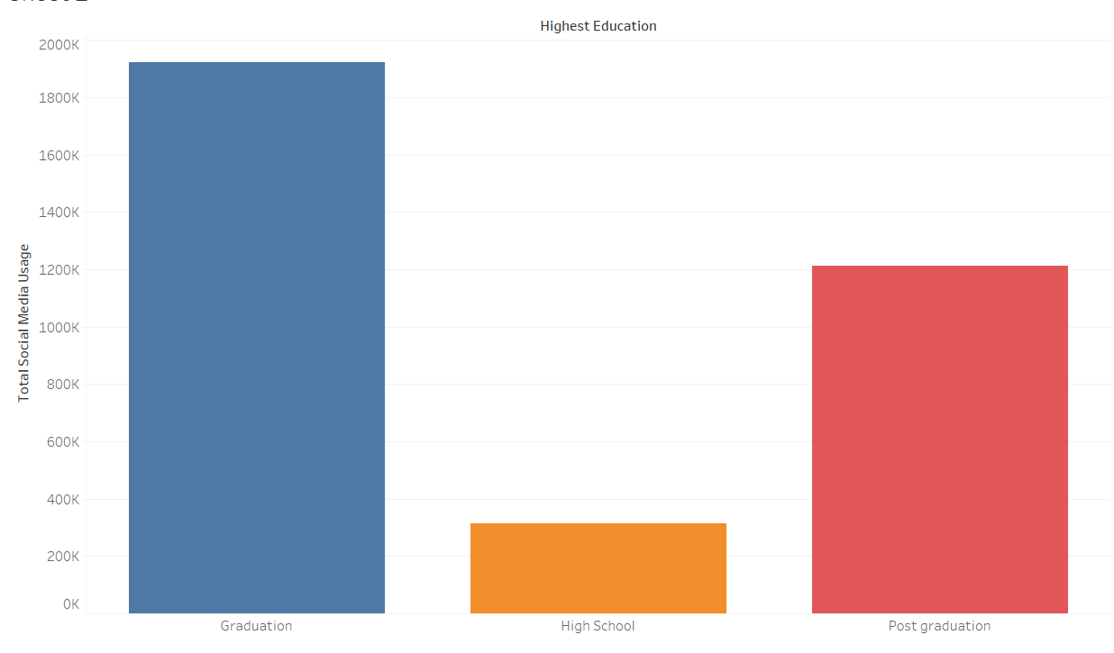
Social media usage according to:
Highest Education
Gender

